Slide 1
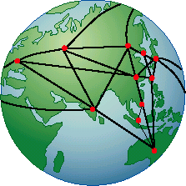
Computer Networks

Slide 2

Computer Networks
Lin Weiguo Prof.
School of Computer Science & Cybersecurity
Copyleft © 2003~2020
linwei@cuc.edu.cn
http://tlc.cuc.edu.cn
Notes:
Computer networks are nearly ubiquitous today. And, new applications extending their use are being developed daily. They are essential to numerous distributed systems and exciting applications.
This course will provide a modern introduction to the dynamic field of computer networks. It will provide fundamental understanding as well as insights to understanding today's networks and those of the future. In this course, we will use the public Internet as our main example for discussing computer networks and their protocols.

Slide 3
Roadmap
Introduction
Physical Layer
Data Link Layer
Medium Access Sublayer
Network Layer
Transport Layer
Application Layer
Notes:
Every one should present himself

Slide 4
Introduction
Chapter 1

Slide 5
Topics
1.1 Uses of computer networks
1.2 Network Hardware
1.3 Network Software
1.4 Reference Models
1.5 Example Networks
1.6 Network Standardization
Some of the overall issues we’ll be dealing with in this course.

Slide 6
A Computer Network
Communication Link
A collection of computers interconnected by communication links
Notes:
Through the book we ill use the term “computer network” to mean a collection of autonomous computers interconnected by a single technology. Two computers are said to be interconnected if they are able to exchange information. The connection need not be via a copper wire; fiber optics, microwave, infrared, and communication satellites can also be used. Networks come in many sizes, shapes and forms, as we will see later. They are usually connected together to make larger networks, with Internet being the most well-known example of a network of networks.
Can You Live Without The Internet?
The internet dominates our lives about this there is no doubt. We are attached to our e-mail accounts and rely extensively on the internet for all kinds of online research and services, whether it is on health and diet, political news, fashion or food recipes. In a study published recently in the Journal of Affective Disorders, examined the habits of 20 people who had spent more than 30 nonworking hours a week online for the past three years. The participants described skipping sleep, ignoring family responsibilities, and showing up late for work to fulfill their desire to visit chat rooms and surf the Web. The consequences were severe: Many suffered from marital problems, failed in school or lost a job, and accumulated debt.
The Internet is an amazing tool which can instantly connect you to people and information all over the world, but do you ever find yourself spending lots of time on the net, surfing for information, checking your e-mails, playing video games or watching videos on YouTube?
People have been asked what they thought was the most important item in their daily life: the computer, mobile phone or television. The majority of the readers chose their computers, followed closely by mobile phones.
A huge majority of people log on to the internet several times a day or are constantly online (either at home or in office). In terms of exact hours, the majority stay connected between 1 to 2 hours, either checking e-mails or just browsing the Net. It is evident that income may not anything to do with how much time one spends online.
People have been asked what they thought was the most important item in their daily life: the computer, mobile phone, television or any broadband tool. The majority of the readers chose their computers, followed closely by mobile phones.
A huge majority of people log on to the internet several times a day or are constantly online (either at home or in office). In terms of exact hours, the majority stay connected between 1 to 2 hours, either checking e-mails or just browsing the Net. It is evident that income may not anything to do with how much time one spends online.
Now its your turn to talk, are you hooked to the internet…

Slide 7
1.1 Uses of Computer Networks
Business Applications
Home Applications
Mobile Users
Social Issues
Notes:
The Internet addiction ?
Some say:
I am one of the addicted users. Every day im on my computer. I have lost almost all my friends & now people make up excuses of why they cant do anything when I call. So im on my computer even more because of this. I have become addicted to pornography lately because I’m on it so much. I have barely even started puberty but yet I am constantly masturbating to ease my guilt/anger. I don’t have any suicidal thoughts but sometimes I get mad at God for this. I have significantly decreased my grades in school because I would rather be on my computer than working. The computer has changed my personality. I used to be a very funny, sports loving, nice guy. But since my addiction, my attitude is different. I talk a lot about Youtube & other websites & it is really annoying to other people. This is the main reason I have lost all my friends, my personality change. Now I have also become rude to other people so that the people that are mean to me will focus on this other person and hurt his feelings. I also am constantly playing video games on my 360, but that is kind of different, all my friends are on their xbox’s a lot too, but not as much as me. It’s really embarrassing when I’m asked what I did over the weekends & all i can say is that i didnt do anything. I’m in the 8th grade & have barely started puberty. I just hope that by highschool everyting will change & i wont be addicted b/c i will get so screwed by not doing my homework & not studying. If anyone can help please do. Digg username= Zimmbear, but i’ve for some reason been blocked & i think i sent an email to them but i gave them the wrong ip address. Please help

Slide 8
Business Applications
Companies have a great number of computers
Monitor productions, keep track of inventories, do the payroll…
Those computers may have worked in isolation from the others, but at some point, management may have decided to connect them to be able to distribute information throughout the company.

Slide 9
1st goal: Resource Sharing
The goal is to make all programs, equipment, and especially data available to anyone on the network without regard to the physical location of the resource and the user.
Equipment:
Printers, Scanner, CD-Burners…
Information:
Customer records, Product information ,inventories, financial statements, tax information …
Notes:
Attempt to end the “tyranny of geography”
If all of its computers suddenly went down, a bank could not last more than five minutes. A modern manufacturing plant, with a computer-controlled assembly line, would not last even 5 secs. Even a small travel agency or three-person law firm is now highly dependent on computer network for allowing employees to access relevant information and documents instantly.

Slide 10
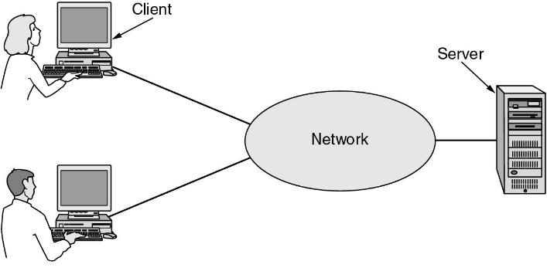

Client machine and Server machine
Data
A network with two clients and one server.
Notes:
Note that we have shown the network as a simple oval, without any detail. We will use this form when we mean a network in the abstract sense. When more detail is required, it will be provided.
C/S model is widely used and forms the basis of much network usage.
e.g. www, the same model is employed.

Slide 11
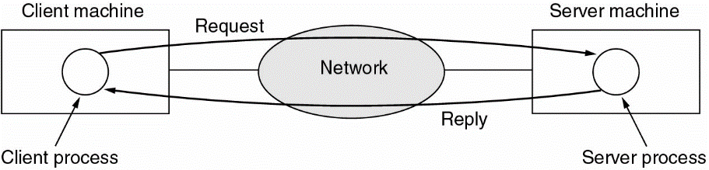
Client/Server model
The C/S model is widely used and forms the basis of much network usage. The most popular realization is that of a Web application.
The client/server model involves requests and replies.
Notes:
If we look at the client-server model in detail, we see that two processes are involved, one on the client machine and one on the server machine. Communication takes the form of the client process sending a message over the network to the server process. The client process then waits for a reply message. When the server process gets the request, it performs the requested work or looks up the requested data and sends back a reply.

Slide 12
2nd goal: A Computer network to do with people
A second goal of setting up a computer network has to do with people rather than information or even computers. A computer network can provide a powerful communication medium among employees.
Email
VoIP
Videoconferencing
Cooperate with other to work: desktop sharing
Notes:
A social network service focuses on building online communities of people who share interests and/or activities, or who are interested in exploring the interests and activities of others. Most social network services are web based and provide a variety of ways for users to interact, such as e-mail and instant messaging services.
Social networking has encouraged new ways to communicate and share information. Social networking websites are being used regularly by millions of people.
While it could be said that email and websites have most of the essential elements of social network services, proprietary encapsulated services gained popularity in the first decade of the 21st century.

Slide 13
3rd goal: e-Commerce
A third goal for many companies is doing business electronically with other companies, especially suppliers and customers.
e-Commerce
B2B: Business to business.
B2C: Business to consumer.
C2C: Consumer to consumer.

Slide 14
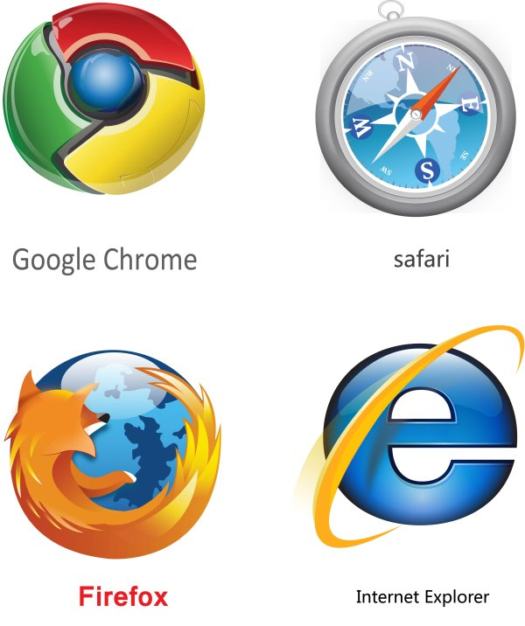













Home Applications
Access to remote information
Web
Person-to-person communication
Email,IM, VoIP
e-commerce
Interactive entertainment
Online Video, Gaming
Notes:
People initially bought computers for word processing and games.
Recently, the biggest reason to buy a home computer was probably for Internet access.
Metcalf’s law. The value of a network is proportional to the square of the number of users because this is roughly the number of different connections that may be made.

Slide 15


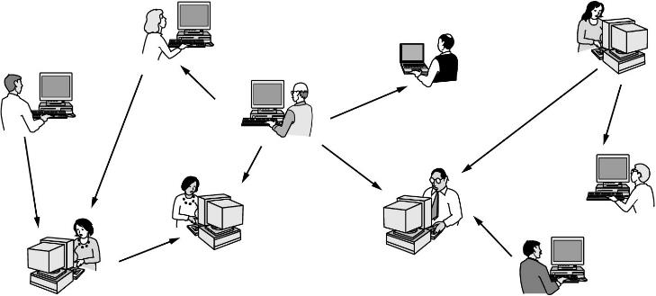
P2P - Peer to Peer
In peer-to-peer system there is no fixed division into clients and servers.
Notes:
in this form, individuals who form a loose group can communicate with others in the group, as shown in the figure. Every person can, in principle, communicate with one or more other people; there is no fixed division into clients and servers.
Peer-to-peer, a distributed computing architecture
Another type of person-to-person communication often goes by the name of p2p communication, to distinguish it from the client-server model.

Slide 16
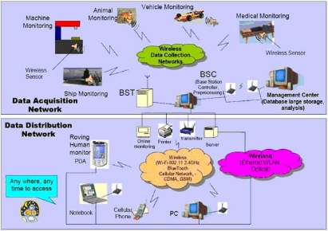


Other applications
Ubiquitous computing
IOT ( Internet of Things)
Sensor Networks
RFID (Radio Frequency IDentification)

Slide 17
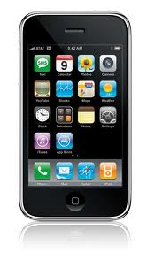

Mobile Users
Combinations of wireless networks and mobile computing.

Slide 18

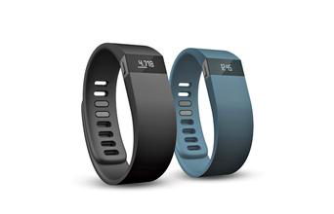
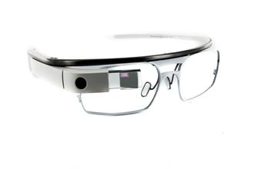
Wearable Computers
Notes:
The Fitbit Charge is essentially a replacement to the recalled Fitbit Force. It's a wrist-worn tracker that sports a rubber strap and small OLED display that shows your current data such as time, steps, and calories burned. It's a click up from the popular Fitbit Flex which doesn't show your data on the actual device, so it makes it a better option for those looking to view stats right on the device.
Fitbit Inc. is a company headquartered in San Francisco, California, United States. Founded and managed by James Park and Eric Friedman, the company is known for its products of the same name, which are activity trackers, wireless-enabled wearable devices that measure data such as the number of steps walked, quality of sleep and other personal metrics. The first of these was the Fitbit Tracker.

Slide 19
Social Issues
Social networking issues
Employee rights vs employer rights
Government vs citizen
Hacker and criminal
Copyright protection
……
Again, The Internet addiction ?

Slide 20
1.2 Network Hardware
Taxonomy of Networks
Personal Networks
Local Area Networks
Wide Area Networks
Wireless Networks
Notes:
Taxonomy [tæk'sɒnəmɪ]分类学；分类法

Slide 21
Classifying networks
By transmission technology
By scale
Notes:
There is no generally accepted taxonomy into which all computer networks fit, but two dimensions stand out as important: transmission technology and scale.
We will now examine each of these in turn.

Slide 22
Transmission technology
Types of transmission technology
Broadcast links
Point-to-point links
Notes:
Broadly speaking,

Slide 23
Point-to-point links
Point-to-point links connect individual pairs of machines.
Packets : short messages
To go from the source to the destination, a packet on a network made up of point-to-point links may have to first visit one or more intermediate machines.
Often multiple routes, of different lengths, are possible
Unicasting:
exactly one sender and one receiver
Notes:
Point-to-point transmission with one sender and one receiver is sometimes called uncasing.

Slide 24

Broadcast Networks
Broadcast networks have a single communication channel that is shared by all the machines on the network.
Packets sent by any machine are received by all the others.
An address field within the packet specifies the intended recipient. Upon receiving a packet, a machine checks the address field. If the packet is intended for the receiving machine, that machine processes the packet; if the packet is intended for some other machine, it is just ignored.
Notes:
As an analogy, consider someone standing at then end of a corridor with many rooms off it and shouting “waton, come here, I want you”. Although the packet may actually be received/heard by many people, only Watson responds. The others just ignore it.
Another analogy is an airport announcement asking all flight 644 passenger to report to gate 12 for immediate boarding .

Slide 25
Broad/Multi-casting
Broadcasting
address a packet to all destinations by using a special code in the address field .
Multicasting
Some broadcast systems also support transmission to a subset of the machines
Notes:
One possible scheme is to reserve one bit to indicate multicasting. The remaining n - 1 address bits can hold a group number. Each machine can ''subscribe'' to any or all of the groups. When a packet is sent to a certain group, it is delivered to all machines subscribing to that group.

Slide 26
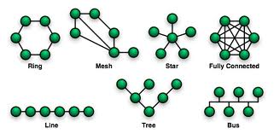
Network Topologies
Think of a topology as a network's virtual shape or structure.
Router
Notes:
In computer networking, topology refers to the layout of connected devices. This article introduces the standard topologies of networking.
Topology in Network Design
Think of a topology as a network's virtual shape or structure. This shape does not necessarily correspond to the actual physical layout of the devices on the network. For example, the computers on a home LAN may be arranged in a circle in a family room, but it would be highly unlikely to find a ring topology there.
Network topologies are categorized into the following basic types:
bus
ring
star
tree
mesh
More complex networks can be built as hybrids of two or more of the above basic topologies.

Slide 27
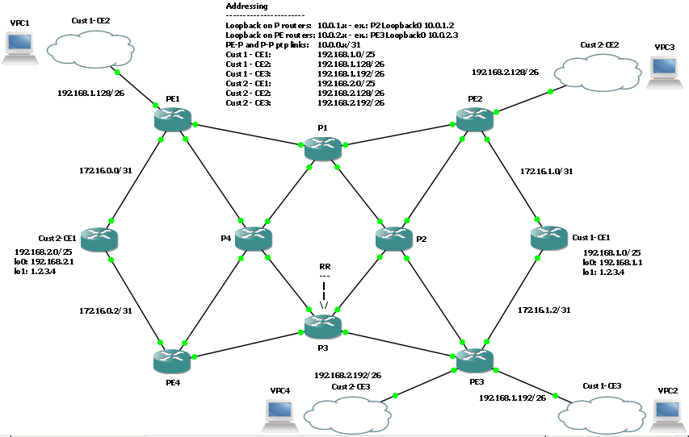
Example of a Real network

Slide 28
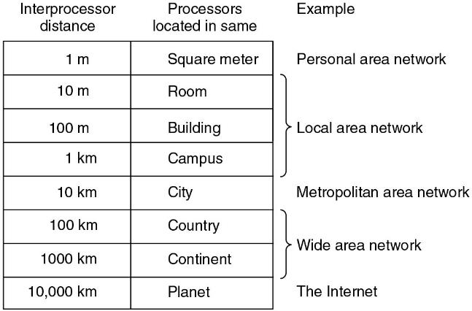
Classification by scale.
Notes:
An alternative criterion for classifying networks is by scale. Distance is important as a classification metric because different technologies are used as different scales.
In this class, we will be concerned with networks at all these scales. In the following sections, we give a brief introduction to network hardware by scale.

Slide 29


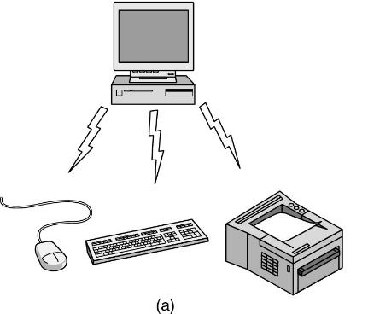
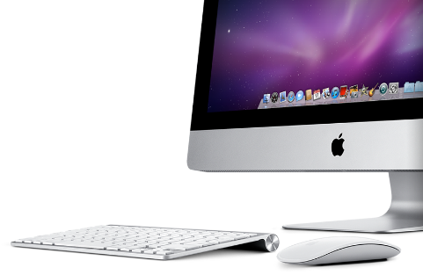
PAN (Personal area networks)
Bluetooth ( IEEE 802.15 )
Notes:
radio frequency identification devices

Slide 30
Local Area Networks
A LAN is a privately owned network that operates with in and nearby a single building like a home, office or factory.
LANs are widely used to connect personal computers and consumer electronics to let them share resources and exchange information.
Notes:
Local area networks, generally called LANs, are privately-owned networks within a single building or campus of up to a few kilometers in size. They are widely used to connect personal computers and workstations in company offices and factories to share resources (e.g., printers) and exchange information. LANs are distinguished from other kinds of networks by three characteristics: (1) their size, (2) their transmission technology, and (3) their topology.
LANs are restricted in size, which means that the worst-case transmission time is bounded and known in advance. Knowing this bound makes it possible to use certain kinds of designs that would not otherwise be possible. It also simplifies network management.
LANs may use a transmission technology consisting of a cable to which all the machines are attached

Slide 31
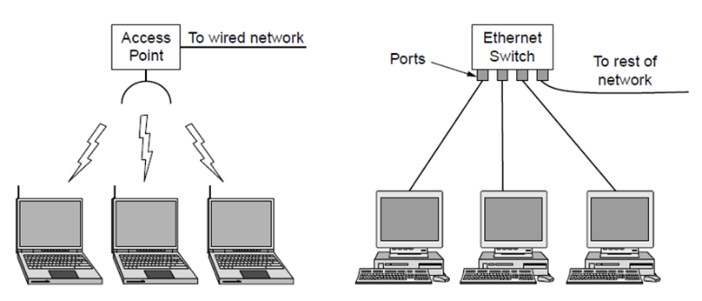
Wireless and wired LANs
Wireless and wired LANs.
(a) 802.11. (b) Switched Ethernet.

Slide 32


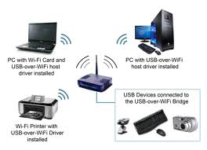
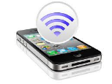
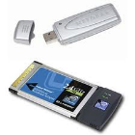
WLAN (Wireless LAN)
Wireless LAN (Wi-Fi IEEE 802.11 )

Slide 33
Wired LAN
Wired LANs charactoristics
Use copper wires, optical fibers
Are restricted in size
Run at speeds of 10Mbps to 1Gbps
Low delay
Make very few errors

Slide 34
Ethernet: IEEE802.3
Ethernet is the most common type of wired LAN
Switched Ethernet
Each computer speaks the Ethernet protocol and connects to a box called a switch with a point-to-point link.
A switch has multiple ports, each of which can connect to one computer. The job of the switch is to relay packets between computers that are attached to it, using the address in each packet to determine which computer to send it to.
Notes:
About the IEEE
Institute of Electrical and Electronics Engineers (Eye-triple-E)
IEEE 802 LAN/MAN Standards Committee
http://www.ieee802.org/

Slide 35
Expand and divide a LAN
Expand a LAN to make it larger
Switches can be plugged into each other using their ports
Divide one larger physical LAN into smaller logical LANs.
VLAN(virtual LAN)
Each switch port is tagged with a “color”, the switch then forwards packets so that computers attached to the same color ports are separated from the others.

Slide 36
Classic Ethernet
The original Ethernet design broadcasts all the packets over a single linear cable.
At most one machine could successfully transmit at a time, and distributed arbitration mechanism was used to resolve conflicts.
Computers could transmit whenever the cable was idle
If two or more packets collided, each computer just waited a random time and tried later.
Notes:
If two

Slide 37
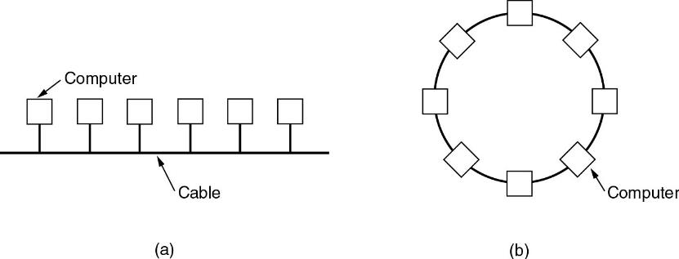
Classic LAN Topologies
Two broadcast networks
(a) Bus (IEEE 802.3, Ethernet)
(b) Ring (IEEE 802.5, Token Ring)
Notes:
In a bus (i.e., a linear cable) network, at any instant at most one machine is the master and is allowed to transmit. All other machines are required to refrain from sending. An arbitration mechanism is needed to resolve conflicts when two or more machines want to transmit simultaneously. The arbitration mechanism may be centralized or distributed. IEEE 802.3, popularly called Ethernet, for example, is a bus-based broadcast network with decentralized control, usually operating at 10 Mbps to 10 Gbps. Computers on an Ethernet can transmit whenever they want to; if two or more packets collide, each computer just waits a random time and tries again later.
A second type of broadcast system is the ring. As with all other broadcast systems, some rule is needed for arbitrating simultaneous accesses to the ring. Various methods, such as having the machines take turns, are in use. IEEE 802.5 (the IBM token ring), is a ring-based LAN operating at 4 and 16 Mbps. FDDI is another example of a ring network.

Slide 38
Channel Allocation methods for Broadcast networks
Static allocation
Divide time into discrete intervals and use a round-robin algorithm, allowing each machine to broadcast only when its time slot comes up.
It wastes channel capacity when a machine has nothing to say during its allocated slot, so most systems attempt to allocate the channel dynamically.
Dynamic allocation
Centralized: there is a single entity which determines who goes next.
Decentralized : there is no central entity , each machine must decide for itself whether to transmit.
Notes:
Broadcast networks can be further divided into static and dynamic, depending on how the channel is allocated. A typical static allocation would be to divide time into discrete intervals and use a round-robin algorithm, allowing each machine to broadcast only when its time slot comes up. Static allocation wastes channel capacity when a machine has nothing to say during its allocated slot, so most systems attempt to allocate the channel dynamically (i.e., on demand).
Dynamic allocation methods for a common channel are either centralized or decentralized. In the centralized channel allocation method, there is a single entity, for example, a bus arbitration unit, which determines who goes next. It might do this by accepting requests and making a decision according to some internal algorithm. In the decentralized channel allocation method, there is no central entity; each machine must decide for itself whether to transmit. You might think that this always leads to chaos, but it does not. Later we will study many algorithms designed to bring order out of the potential chaos.

Slide 39
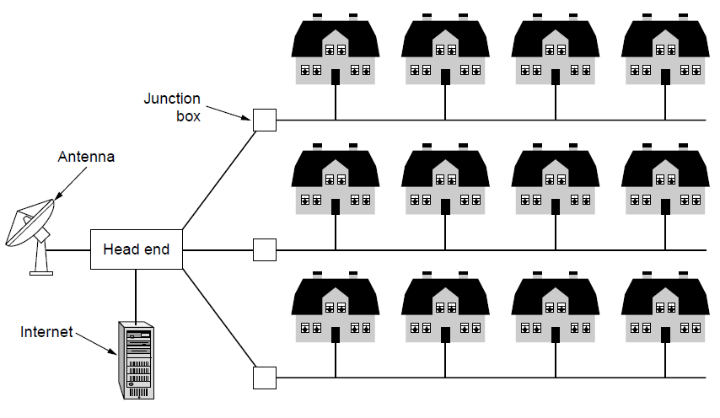
Metropolitan Area Networks
MAN covers a city
A metropolitan area network based on cable TV.

Slide 40
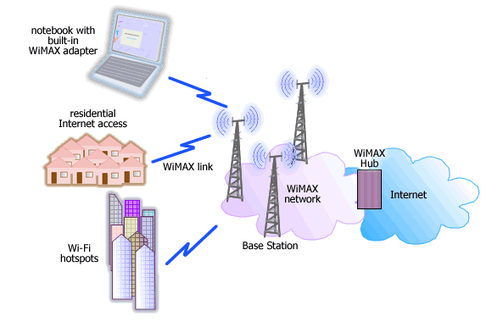

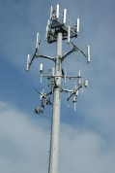
Wireless MAN
WiMax IEEE 802.16
Notes:
美国5G为什么干不过华为？讲述美国通信设备企业玩死自己的过程
WiMAX的坑爹史
2019-04-16 09:40
来源：内容来自「鲜枣课堂」，谢谢。
大家好，我是小枣君。
不知道大家有没有发现，现在我们经常提中国和美国的5G竞争，可是，美国除了高通之外，好像并没有什么很牛掰的通信设备制造企业。而高通，主要是靠芯片和专利行走江湖，也并不是一家设备商。全球四大设备商，中国有中兴华为两家，爱立信是瑞典的，诺基亚是芬兰的。美国一家也没有。
这是为什么呢？
其实，老美曾经也是有一家国际化通信设备商公司的。这家公司历史非常悠久，实力也非常雄厚，它就是著名的——朗讯（Lucent）公司。
举世闻名的贝尔实验室，就是它家的
而且，如果按北美这个阵营来算的话，老美的死党，抓了咱们孟晚舟女士的加拿大，也曾经有一家很厉害的设备商，大家应该也听说过，叫做北电（Nortel）。
那么，问题来了，朗讯和北电，那么有名的两家公司，现在都去哪了呢？
我来告诉大家：朗讯，被收购了，而北电，2009年破产了。
这两家公司的失败，虽然有多方面的原因，但是有一个很重要的因素，就是错误地押宝了一个现在看起来很“坑爹”的通信技术。这项技术，就是我们今天文章的主角——WiMAX。
故事要从上世纪80年代说起。
那时，第一代移动通信技术（1G）开始出现。1G的代表，就是美国的AMPS技术，还有北欧的NMT技术。除此之外，还有英国的TACS、日本的JTACS和西德的C-Netz等。
虽然技术上百家争鸣，但说白了，也就是以美国、欧洲、日本三个地区为主。它们最有实力，并且相互竞争。而包括我们中国在内的其它国家和地区，都只有看热闹的份。
后来，到了2G时代（90年代初），欧洲推出了GSM（全球移动通信系统），而美国不甘示弱，推出了CDMA。通信标准的竞争，变成了美国和欧洲的PK角力。日本虽然也有PDC技术，但基本上没有形成竞争力。
CDMA VS GSM，大家应该不陌生
接着，到了3G时代（本世纪初），这场游戏就更精彩了。
那个时候，欧洲凭借GSM的成功，在电信行业继续拥有领先地位。排名靠前的通信企业，包括爱立信（瑞典）、诺基亚（芬兰）、阿尔卡特（法国）、西门子（德国），都是欧洲的。尤其是爱立信，当时是世界通信设备商的带头大哥。
而美国这边呢，通信设备商企业只有摩托罗拉，朗讯等，整体实力弱于欧洲。但是，美国在计算机行业拥有领先优势，例如英特尔、IBM、微软这样的IT巨头，都是美国的。
英特尔（Intel）
需要注意的是，美国还有一家公司，高通（就是它推出了CDMA标准）。虽然高通不是设备商，但拥有很多专利，说话很有分量。
高通，Qualcomm
日本呢，其实已经退出了牌局。原因嘛，大家应该也知道，当年贸易战被美国干得半死，加上自身老龄化和经济泡沫等，早已处于全面衰退状况。一些2G时代还有一定实力的日本通信企业，这个时候基本上都倒闭了。
但是，有一个新的玩家崛起了，那就是我们中国。
改革开放后的中国，有世界上最大的市场，还崛起了以华为和中兴为代表的通信设备商（那个时候还比较弱），通信技术发展得很快，逐渐在全球通信领域有了话语权。
当时的形势是这样的：欧洲一堆通信厂商，联合推出了WCDMA技术。凭借它们的实力，WCDMA铁定会成为3G标准，想都不用想。而欧洲这帮人，就是希望全世界都用WCDMA，搞技术垄断。
以老美的风格，当然不答应啊——都用WCDMA，我还玩个P？
所以，它就在CDMA基础上，搞出了CDMA2000，打算和2G时代一样，和欧洲继续对抗，掌握更多的主动权。
但是，老美也明白，凭借自己的力量并不足以和WCDMA抗衡，怎么办呢？
老美很快就想到了中国，拉个盟友呗！
据说，在敲定全球3G标准的时候，为了能让CDMA2000成为3G标准之一，美国代表团团长安排手下的华人团员私下找到中国代表团团长，约了个饭局。饭局之上，美国人直奔主题：“你们的TD不是也想进标准吗？咱们得抱团啊，不能让欧洲操控我们！你看这样行不，我们支持TD-SCDMA，你们支持CDMA2000，我们一起进标准，咱们得这样balabala……”。
美国当然不在乎中国的TD标准是否能成为标准，反正他们也不会推广。让中国标准通过，无非是在国际电信联盟中多份文件，对他们没有任何实质性影响。而利用中国的支持，让自家的CDMA2000成为标准，那才是它想要的结果。
而中国呢？由于是第一次冲击标准，能否成功心里根本就没底。所以，既然老美肯帮忙，双方各取所需，就这么干呗！
于是，双方就达成了默契。
到了第二天开会，是美国轮值。中国代表发言，称多个国际标准同时运行是国际社会更正确的选择，道理balabala。。。美国代表马上表态：“中国人说得对！支持！” 然后集体鼓掌，剩下欧洲人一脸懵逼。。。
于是乎，2000年5月，欧标WCDMA、美标CDMA2000、中标TD-SCDMA就共同成为3G国际标准。
所以说，国际电信标准的争夺，从来就不仅仅是技术本身问题，而是强国之间角力、对抗、勾结、妥协的过程。它事关本国电信企业发展的大局，必须采取各种手段，包括阴谋阳谋，争取对自己国家有利的局面。这种权力的游戏，没有实力的国家根本连参与的资格都没有。
不扯远了，继续回到主题。我们的主角还没登场呢。
按理来说，三大标准已定，大家各回各家，各找各妈，完事。可是，故事并没有结束。
没过几年，以Intel为首的美国“IT帮”，跳出来掺局了。他们推出了极具竞争力的WiMAX技术，向“电信帮”发起挑战。
WiMAX是何方神圣？
WiMAX，就是Worldwide Interoperability for Microwave Access，全球微波互联接入。名字有点长，它还有另外一个名字，简单多了，就5个数字——802.16。
从802.16这个名字就能看出它和802.11（无线局域网，也就是Wi-Fi）之间的关系。是的，WiMAX和Wi-Fi都是IEEE所定义的通信技术协议标准。
IEEE，电气与电子工业协会
Wi-Fi大家都很熟悉，是局域网技术。而WiMAX，是城域网技术。
其实，简单来说，WiMAX就是加强版的Wi-Fi。
加强到什么程度呢？Wi-Fi最多无障碍传输几百米，WiMAX呢，理论上可以传输50公里。。。除此之外，它还有传输速率高、业务丰富多样等特点。
WiMAX采用了许多新的技术，如OFDM正交频分多址和MIMO多天线等（是不是很眼熟？），极大地提高了数据传输能力，受到行业追捧。
在技术优势明显、市场前景广阔的情况下，WiMAX迅速成为通信圈的新宠，极大地动摇了3GPP和3GPP2的地位，对传统三大3G标准构成了实质威胁。
警钟敲响，传统通信厂家迅速清醒过来，组织进行反击。不久后，3GPP推出了LTE技术，与WiMAX进行抗衡。前面所说的OFDM和MIMO，全部都在LTE中采用，算是“师夷长技以制夷”了。
正如前面所说，WiMAX简单理解就是Wi-Fi的加强版，所以，它实际上并不算是移动通信技术，而是基于IP网络之上，是IT技术往电信领域的“入侵”。
WiMAX技术主导者是Intel、IBM、摩托罗拉、北电，以及北美一些运营商。Intel与摩托罗拉向WiMAX项目注资9亿美元，算是开了张。紧接着，美国运营商再注资30亿美元，一下子就把火烧旺起来了。
为了给WiMAX造势，Intel厚着脸皮宣称，WiMAX芯片比传统3G芯片便宜10倍。
这下子，整个行业更加沸腾了。大量的WiMAX相关研究论文被发表，很多企业都纷纷投入到这项所谓“3.5G”技术的怀抱。
眼看形势一片大好，美国当然亢奋啦，搞不好WiMAX能彻底逆袭传统通信呢！
于是，美国开始不惜一切代价支持WiMAX。
首先，先把WiMAX扶植成正式的国际标准再说。毕竟，名不正言不顺，不是标准就等于没有法定身份，也就没有合法频率，根本没法玩。
但是，当时已经是2007年了。前面我们说过，2000年的时候，国际电信联盟就已经敲定了三大3G标准。确切地说，3G标准提交的最终截止时间是1998年6月30日（国际电信联盟曾公告全世界）。现在去加标准，你以为国际电信联盟是你家开的么？
美帝不愧是美帝，这个看似不可能完成的任务，愣是被它搞定了。。。
美国凭借自己的力量，强行打开了国际电信联盟的大门，召开了专题会议，把WiMAX接纳为第四个3G国际电信标准，并如愿地分配到了全球频率。。。
所以说，不服不行啊，谁让它是世界霸主呢。。。
这下好了，WiMAX要钱有钱，要靠山有靠山，要身份有身份，要频段有频段，该有的都有了，真可谓是——“春风得意马蹄疾，一日看尽长安花”。
老大都表态了，那小弟们还不赶紧站队？于是乎，圈子里风云四起，城头变幻大王旗。
加拿大是一贯跟着美国跑的，所以，北电（加拿大）闻风而动，将传统3G业务出售给法国阿尔卡特，然后孤注一掷地全面转向WiMAX。
亚洲，除中国大陆之外，几乎都成了WiMAX的试验田。日本、韩国、马来西亚、菲律宾等都部署了WiMAX。
台湾更不用说了，惟美国马首是瞻，全力押宝WiMAX，争先恐后地抢WiMAX牌照。台湾的全球一动、威迈思电信、远传电信、大众电信、大同电信、威达超舜电讯等六家运营商，都抢到了WiMAX牌照，准备大干一场。
老美看这形势一片大好，就开始得意起来，一方面继续为WiMAX摇旗呐喊，另一方面，鼓动包括中国移动在内的TD-SCDMA运营商加入WiMAX：“TD-SCDMA没有前途，唯一的出路就是向WiMAX靠拢。”
为啥要扯上中国的TD-SCDMA呢？因为两者都使用了TDD（时分双工）机制，和WCDMA的FDD不同。所以，WiMAX和TD-SCDMA之间更有替代性。
中国当然不乐意啊，凭什么听你的？于是，没有永远的朋友，也没有永远的敌人，中国这次选择和欧洲站在了一起。
欧洲对美国的做法是很不爽的——让你搞了个CDMA2000，你又搞个WiMAX，有完没完啊？诺基亚的高管当时就站出来，公开批评WiMAX，把Intel惹恼了，两边隔空对骂，吵得不亦乐乎。整个行业里的气氛就很紧张，大家明争暗斗，都想搞死对方。
中国的态度，改变了WiMAX命运天平的倾斜方向。
仔细分析一下当时的实力对比：全球通信设备商，有实力的就那么几家，爱立信（瑞典）、阿尔卡特（法国）、西门子（德国）、华为（中国）、中兴（中国）、北电（加拿大）、朗讯（美国）、摩托罗拉（美国），掰掰手指就能算出孰弱孰强了。何况，朗讯被阿尔卡特收编了，美国也就高通在电信领域有点实力。高通又是一个芯片和专利商，压根不造设备。
更坑爹的是，高通还是个“叛徒”。高通在传统通信领域有很多既得利益，三大3G标准（WCDMA、CDMA2000、TD-SCDMA），其实都是基于它的CDMA，所以，它根本不希望发展WiMAX。虽然高通自己的UMB（基于CDMA2000演进的4G）黄了，但LTE还是对它有利。
所以，高通和WiMAX联盟的谈判失败后，干脆它所有的芯片都不支持WiMAX，而Intel当时也没有预见到智能手机的崛起，所以根本没有重点发展手机芯片。。。
心有余而力不足的Intel，加上麾下一群酱油党，结果可想而知了。
没有设备，没有芯片，没有成熟的产业链，你还怎么玩？
所以说，这场战役其实已经分出了输赢。
不出所料，在缺乏产业链支持的情况下，WiMAX的形势急转直下。
因为网络设施跟不上，芯片供应跟不上，产业链发展严重不足，WiMAX的使用体验非常差，WiMAX阵营开始瓦解。
澳大利亚最早部署WiMAX的运营商老总首先开炮，在国际会议上痛骂WiMAX，说室内覆盖在区区400米就不行了，时延高达1000毫秒。（去年的会议上，他还曾对WiMAX赞不绝口呢。）
然后，到了2010年，WiMAX标准的最大支柱Intel先撑不住了，宣布解散WiMAX部门。这就搞笑了，带头大哥都跑了，还怎么玩？（这也充分证明，美帝卖起队友来，真是眼睛都不会眨一下。）
美队，你个浓眉大眼的也叛变革命了？
再然后，当初孤注一掷转向WiMAX的加拿大北电，破产了。。。
一看大事不妙，马来西亚、菲律宾、韩国等亚洲国家纷纷跳船跑路，由WiMAX向TD-LTE转。
就连全球最大的WiMAX服务提供商，美国Clearwire公司，也“叛变”了。。。它把业务重心由WiMAX转向了TD-LTE，2011年9月宣布与中国移动达成合作伙伴关系，共同推进基于TD-LTE标准的产品与设备开发。
什么叫墙倒众人推，这就是了。
这下可好，当初美国吹牛逼，TD-SCDMA只有转向WiMAX一条路。这才几年，就变成“WiMAX只有转向TD-LTE一条路”。真可谓是“风水轮流转，苍天饶过谁”啊。
最苦逼的是我们的台湾同胞。
台湾对WiMAX跟得最紧，下注最大，现在傻眼了。想调头？谈何容易。WiMAX的产业结构都建立了，频段也都分出去了，哪能说调头就调头啊？
自2010年WiMAX帝国开始崩塌后，台湾又独自在WiMAX上苦撑了两年。2012年一盘账，发现六家运营商的WiMAX用户加起来还没有15万，连内地一个县都不如。
全球一动先撑不住了，要舍弃WiMAX投靠TD-LTE。但按台湾监管机构的规定，只有完成70%的覆盖时，才可申请向LTE转换，这可就把运营商整死了。而且，监管机构已经把最好的高端频率都分给WiMAX了，运营商想改道也不行，因为没有频率可以用。想让监管机构收回WiMAX频段，重新分配给TD-LTE，更难啊。
就这一下，彻底伤了台湾通信行业的元气。不仅损失了500亿美元的投资，还毁掉了产业，浪费了时间。到现在都十年了，还没缓过劲来。。。
话说回来，我们的台湾同胞也真是可怜，除了WiMAX这事被美帝坑惨之外，液晶面板也被韩国三星棒子坑得生活不能自理，现在就只剩下半导体在死撑，唉，想想也是悲催。
所以说啊，不怕神一样的对手，就怕猪一样的队友。
其实，也不能完全怪台湾傻，问题的关键还是因为实力太弱。手上没有自己的标准，而且在生态链中没有自己的地位，遭遇这样的境遇，也是迟早的事。
你就这点家底，还敢跟着大佬们玩大牌局？人家家大业大，输了大不了从头再来，你老本一下子就输光了，还怎么玩下去？再加上，你好歹要跟对老大啊，跟个没良心的，那不是自己送人头当炮灰么。
总而言之，WiMAX阵营彻底输掉了这场战争，WiMAX这个词，逐渐淡出了我们的视野。
欧洲和中国赢得了最终的胜利，LTE也如愿成为了4G标准，有了无法撼动的正统地位。
而美国这边呢，一片惨淡。。。北电没了，朗讯卖了，摩托废了，不过，“叛徒”高通还在。。。
尘埃落定之后，世界通信行业格局也逐渐变成了现在的样子。
转眼之间，十年过去了。往事虽然如过眼云烟，但回想起来仍然是心惊肉跳。如果当初我们不慎走错了方向，也许今天的全球通信行业竞争格局，就是另外一幅场景了。我们也不一定会有现在的地位和优势。
如今，斗争还在继续，通信行业依旧是暗流涌动、剑拔弩张，各方势力此消彼长、合纵连横。充满未知的将来，究竟谁能笑到最后，只能让时间来告诉我们答案了。

Slide 41
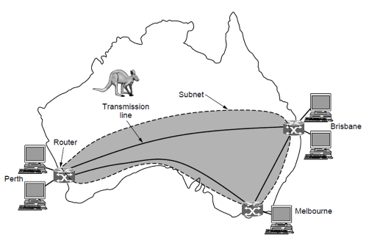
Wide Area Networks
A WAN spans a large geographical area, often a country or continent.
WAN that connects three branch offices in Australia

Slide 42
Communication subnet
Transmission lines
copper wire, optical fiber, or even radio links.
Most companies do not have transmission lines lying about, so instead they lease the lines.
Switching elements
Switches are the specialized computers called routers that connect two or more transmission lines
Subnet:
A collection of routers and communication lines that moved packets from the source host to the destination.
Notes:
Subnet在第五章IP地址指 CIDR subnet
In most wide area networks, the subnet consists of two distinct components: transmission lines and switching elements. Transmission lines move bits between machines. They can be made of copper wire, optical fiber, or even radio links.
Switching elements are specialized computers that connect three or more transmission lines. When data arrive on an incoming line, the switching element must choose an outgoing line on which to forward them. These switching computers have been called by various names in the past; the name router is now most commonly used.

Slide 43
Differences between WAN &LAN
In WAN, the hosts and subnet are owned and operated by different people
The routers will usually connect different kinds of networking technology.
What is connected to the subnet:
Individual computers
Could be entire LANs
This is how larger networks are built from smaller ones
Notes:
the WAN as we have described it looks similar to a large wired LAN, but there are some important differences that go beyond long wires. Ususally in a WAN, the hosts and subnet are owned and operated by different people. In our example, the employee might be responsible for their own computers, while the company’s IT department is in charge of the rest of the network. We will see clearer boundaries in the coming examples, in which the network provider or telephone company operates the subnet. Separation of the pure communication aspects of the network(subnet) from the application aspects (hosts) greatly simplifies the overall network design.
A second difference is that the router will usually connect different kinds of networking technology, the networks inside the offices may be switched ethernet, for example, while the long-distance transmission lines may be SONET links. Some device need to join them.
This means that many WANs will in fact be internetworks, or composite networks that are made up of more than one network.
A final difference is in what is connected to the subnet. This could be individual computers, as was the case for connection to LANs, or it could be entire LANs. This is how larger networks are build from smaller ones. As far as the subnet is concerned, it does the same job.

Slide 44
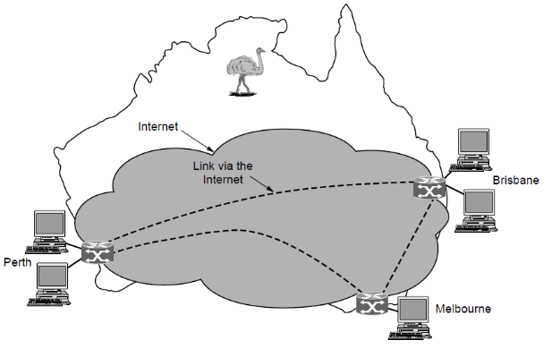
WAN via the Internet
VPN: flexible but lack control
WAN using a virtual private network.
Notes:
We are now in a position to look at two other varieties of WANs.
Rather than lease dedicated transmission lines, a company might connect its office to the internet. This allows connections to be made tetween the offices as virtual links that use the underlying capacity of the Internet. This arrangement is called a VPN. Compared to the dedicated arrangement.
A VPN has the usual advantage of virtualization, which is that it provides flexible reuse of a resource (Internet connectivity). Consider how easy it is to add a fourth office to see this. A VPN also has the usual disadvantage of virtualization, which is a lack of control over the underlying resource.
With a dedicated line, the capacity is clear. With a VPN your mileage may vary with your Internet service.

Slide 45
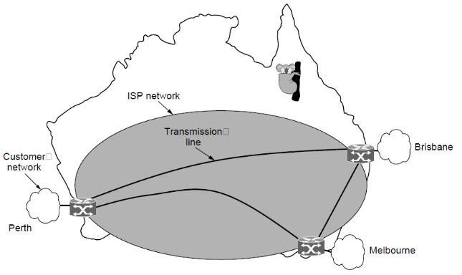
WAN via ISP network
The subnet is run by Internet Service Provider
WAN using an ISP network.
Notes:
Internet service provider.
The second variation is that the subnet may be run by a different company. The subnet operator is known as a network service provider and the offices are its customers.
The subnet operator will connect to other customers too, as long as they can pay and it can provide service.
The subnet operator will also connect to other networks that are part to the Internet.

Slide 46
WAN Terms
Packet / Cell
the message is cut into packets before sending
Packet-switched / store-and-forward
the packet is received at each intermediate router in its entirety, stored there until the required output line is free, and then forwarded.
Routing algorithm
There may be many paths in the network that connect two computers. How the network makes the decision as to which path to use is called the routing algorithm.
Notes:
In most WANs, the network contains numerous transmission lines, each one connecting a pair of routers. If two routers that do not share a transmission line wish to communicate, they must do this indirectly, via other routers. When a packet is sent from one router to another via one or more intermediate routers, the packet is received at each intermediate router in its entirety, stored there until the required output line is free, and then forwarded. A subnet organized according to this principle is called a store-and-forward or packet-switched subnet. Nearly all wide area networks (except those using satellites) have store-and-forward subnets. When the packets are small and all the same size, they are often called cells.

Slide 47
Internet
Internetworks:
Collection of interconnected networks.
internet (lower case i) is generic term.
Internet (upper case I) is worldwide connection to all kinds of machines.

Slide 48
1.3 Network Software
Protocol Hierarchies
Design Issues for the Layers
Connection-Oriented and Connectionless Services
Service Primitives
The Relationship of Services to Protocols
Notes:
The first computer networks were designed with the hardware as the main concern and the software as an afterthought. This strategy no longer works. Network software is now highly structured.
In the following sections we examine the software structuring technique in some detail. The method described here forms the keystone of the entire book and will occur repeatedly later on

Slide 49
Philosophy of Protocol Hierarchies
Layering:
To reduce their design complexity, most networks are organized as a stack of layers or levels, each one built upon the one below it.
Services:
The purpose of each layer is to offer certain service to the higher layer, shielding those layers from the details of how the offered services are actually implemented.
Notes:
This concept is actually a familiar one and used throughout computer science, where it is variously known as information hiding, abstract data types, data encapsulation, and object-oriented programming. The fundamental idea is that a particular piece of software (or hardware) provides a service to its users but keeps the details of its internal state and algorithms hidden from them.

Slide 50
Layer n Protocol
Layer n on one machine carries on a conversation with layer n on another machine. The rules and conventions used in this conversation are collectively known as the layer n protocol.
A protocol is an agreement between communicating parties on how communication is to proceed.

Slide 51
What Is A Protocol
Human protocols:
“what’s the time?”
“How are you doing?”
“I have a question”
- Specific messages sent
- Specific actions taken when messages received, or other events
Network protocols:
Machines rather than humans
All communication activity in Internet governed by protocols
Protocols define format, order of messages sent and received among network entities, and actions taken on message transmission and receipt.
Notes:
Basically, a protocol is an agreement between the communicating parties on how communication is to proceed.

Slide 52
Protocol Example
Human Network
TCP connection request
“Hello”
“Hello”
TCP connection reply
“Got the time?”
HTTP request
“It’s 10:30”
HTTP response

Slide 53
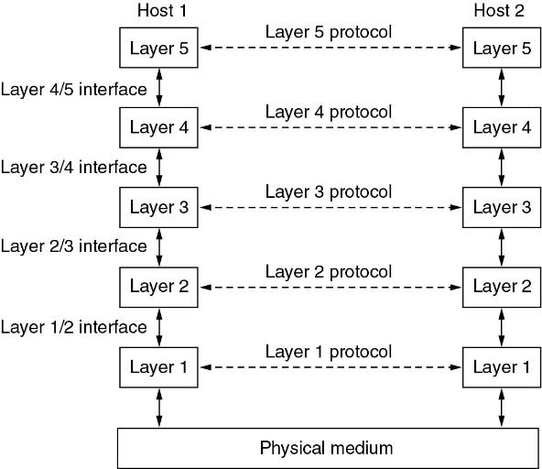
Protocol Hierarchies
Virtual communication
Peers
Physical communication
Layers, protocols, and interfaces.
Notes:
A five-layer network is illustrated in Fig. 1-13. The entities comprising the corresponding layers on different machines are called peers. The peers may be processes, hardware devices, or even human beings. In other words, it is the peers that communicate by using the protocol.
In reality, no data are directly transferred from layer n on one machine to layer n on another machine. Instead, each layer passes data and control information to the layer immediately below it, until the lowest layer is reached. Below layer 1 is the physical medium through which actual communication occurs. In Fig. 1-13, virtual communication is shown by dotted lines and physical communication by solid lines.

Slide 54
Hierarchy Example
Name
Name
Address
Address
Post Office
Post Office
Notes:
The peers may be processes, hardware devices, or even human beings. In other words, it is the peers that communicate by using the protocol

Slide 55
Terminology
Peers
The entities comprising the corresponding layers on different machines are called peers. The peers may be processes, hardware devices, or even human beings. In other words, it is the peers that communicate by using the protocol.
Interface:
Between each pair of adjacent layers is an interface. The interface defines which primitive operations and services the lower layer makes available to the upper one.

Slide 56
KISS principle
"Keep It Simple, Stupid",
Important to keep it simple and clean to reduce complexity.
How many layers?
Clean interfaces
Important that each layer perform a specific collection of well-understood functions.

Slide 57
Network architecture
Network architecture: A set of layers and protocols.
The spec must contain enough information to allow an implementer to write the program or build the hardware for each layer so that it will correctly obey the appropriate protocol.
Functional interfaces and implementation details are not part of the spec, since that's not visible outside the machine.
It is not even necessary that the interfaces on all machines in a network be the same, provided that each machine can correctly use all the protocols.
Notes:
The specification of an architecture must contain enough information to allow an implementer to write the program or build the hardware for each layer so that it will correctly obey the appropriate protocol. Neither the details of the implementation nor the specification of the interfaces is part of the architecture because these are hidden away inside the machines and not visible from the outside. It is not even necessary that the interfaces on all machines in a network be the same, provided that each machine can correctly use all the protocols.

Slide 58
Protocol stack
Protocol stack:
A list of protocols used by a system, one protocol per layer, is called a protocol stack.
Network architectures, protocol stacks, and the protocols themselves are the principal subjects of this course

Slide 59
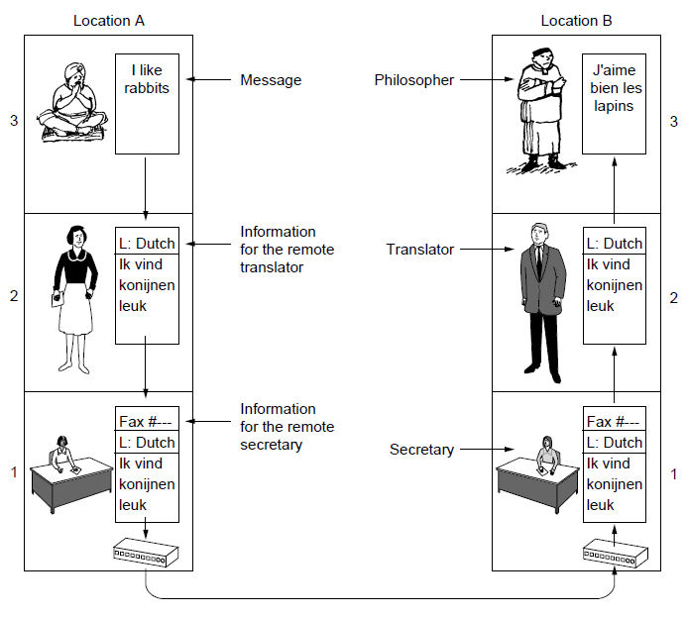
Analogy of Protocol Hierarchies
Urdu
English
Chinese
French
The philosopher-translator-secretary architecture.
Notes:
An analogy may help explain the idea of multilayer communication. Imagine two philosophers (peer processes in layer 3), one of whom speaks Urdu and English and one of whom speaks Chinese and French. Since they have no common language, they each engage a translator (peer processes at layer 2), each of whom in turn contacts a secretary (peer processes in layer 1). Philosopher 1 wishes to convey his affection for oryctolagus cuniculus to his peer. To do so, he passes a message (in English) across the 2/3 interface to his translator, saying ''I like rabbits,'' as illustrated in Fig. 1-14. The translators have agreed on a neutral language known to both of them, Dutch, so the message is converted to ''Ik vind konijnen leuk.'' The choice of language is the layer 2 protocol and is up to the layer 2 peer processes.
The translator then gives the message to a secretary for transmission, by, for example, fax (the layer 1 protocol). When the message arrives, it is translated into French and passed across the 2/3 interface to philosopher 2. Note that each protocol is completely independent of the other ones as long as the interfaces are not changed. The translators can switch from Dutch to say, Finnish, at will, provided that they both agree, and neither changes his interface with either layer 1 or layer 3. Similarly, the secretaries can switch from fax to e-mail or telephone without disturbing (or even informing) the other layers. Each process may add some information intended only for its peer. This information is not passed upward to the layer above.

Slide 60
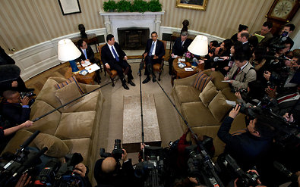
Virtual Communication: Sino-US Talk
Xi Jinping meets with Barack Obama.

Slide 61
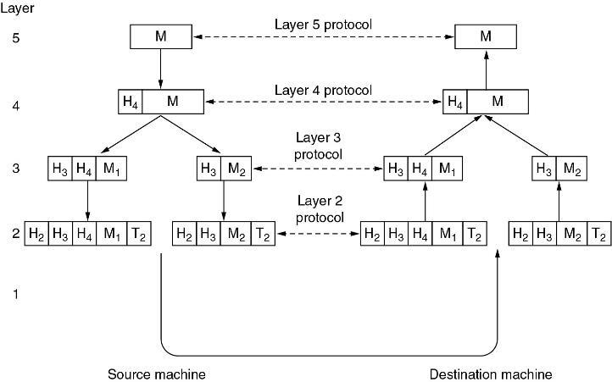
Information flow
“Horizontal”
Example information flow supporting virtual communication in layer 5.
Layer4 thinks "SendtoPeer" rather than “CallNextLayerDown".
Notes:
Now consider a more technical example: how to provide communication to the top layer of the five-layer network in Fig. 1-15. A message, M, is produced by an application process running in layer 5 and given to layer 4 for transmission. Layer 4 puts a header in front of the message to identify the message and passes the result to layer 3. The header includes control information, such as sequence numbers, to allow layer 4 on the destination machine to deliver messages in the right order if the lower layers do not maintain sequence. In some layers, headers can also contain sizes, times, and other control fields.
In many networks, there is no limit to the size of messages transmitted in the layer 4 protocol, but there is nearly always a limit imposed by the layer 3 protocol. Consequently, layer 3 must break up the incoming messages into smaller units, packets, prepending a layer 3 header to each packet. In this example, M is split into two parts, M₁ and M₂.
Layer 3 decides which of the outgoing lines to use and passes the packets to layer 2. Layer 2 adds not only a header to each piece, but also a trailer, and gives the resulting unit to layer 1 for physical transmission. At the receiving machine the message moves upward, from layer to layer, with headers being stripped off as it progresses. None of the headers for layers below n are passed up to layer n.
The important thing to understand about the figure is the relation between the virtual and actual communication and the difference between protocols and interfaces. Ther peer processes in layer 4, for example, conceptually think of their communication as being horizontal using the layer 4 protocol. Each one is likely to have a procedure called something like Sendto otherside and ger fromotherside, even though these procedures actually communicate with lower layers across the ¾ interface, no with the other side.

Slide 62
Terminology
Header:
Upper layer puts a header in front of the message to identify the message and passes the result to lower layer
The header includes control information such as sequence numbers to keep the right order.
Size of messages
There is always a limit to the size of messages imposed by certain layer protocol. So incoming messages must be broken into smaller units (packets) in this layer.
Notes:
The important thing to understand about Fig. 1-15 is the relation between the virtual and actual communication and the difference between protocols and interfaces. The peer processes in layer 4, for example, conceptually think of their communication as being ''horizontal,'' using the layer 4 protocol. Each one is likely to have a procedure called something like SendToOtherSide and GetFromOtherSide, even though these procedures actually communicate with lower layers across the 3/4 interface, not with the other side.
The peer process abstraction is crucial to all network design. Using it, the unmanageable task of designing the complete network can be broken into several smaller, manageable design problems, namely, the design of the individual layers.

Slide 63
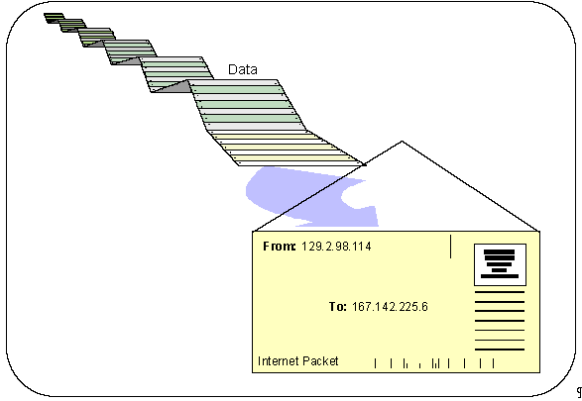
An Internet Envelope

Slide 64
TCP/IP Hierarchies
CRC
CRC
Data
Data
Data
Data
Data
Data
Data
Data
Data
Data
Data
HTTP
HTTP
FTP
FTP
HTTP
HTTP
FTP
HTTP
FTP
HTTP
FTP
FTP
Application
Application
Transport
TCP
Transport
TCP
TCP
UDP
UDP
UDP
TCP
TCP
TCP
UDP
UDP
UDP
Internet
Internet
IP
IP
IP
ICMP
ICMP
ICMP
IGMP
IGMP
IGMP
ARP
ARP
ARP
IP
IP
IP
ICMP
ICMP
ICMP
IGMP
IGMP
IGMP
ARP
ARP
ARP
Preamble
Preamble
ATM
ATM
ATM
Ethernet
Ethernet
Ethernet
ATM
ATM
ATM
Ethernet
Ethernet
Ethernet

Slide 65
Software or hardware?
Although this section is called '‘network software”, it is worth pointing out that the lower layers of a protocol hierarchy are frequently implemented in hardware or firmware. Nevertheless, complex protocol algorithms are involved, even if they are embedded (in whole or in part) in hardware.

Slide 66
Design Issues for the Layers
Reliability
Network Evolution
Resource Location
Against Threats
Notes:
Some of the key design issues that occur in computer networks are present in several layers. Below, we will briefly mention some of the more important ones.

Slide 67
Reliability
Reliability: Making a network that operates correctly even though it is made up of a collection of components that are themselves unreliable.
Mechanisms:
Error detection
Find errors in received information.
Error correction
Fix errors in received information.
Routing
Find a working path through a network.

Slide 68
Network Evolution issue
Protocol Layering
Support change
Addressing or Naming
Every layer needs a mechanism for identifying senders and receivers.
Internetworking
Different network technologies often have different limitations.
Scalable
Design work well when the network gets large

Slide 69
Resource Location
Networks provide a service to hosts from their underlying resource, such as the capacity of transmission lines.
Statistical multiplexing
Share network bandwidth dynamically
Flow control
Keep a fast sender from swamping a slow receiver with data.
Congestion
Network overloading
Quality of Service
Differential service for real-time delivery and other.
Notes:
潮汐车道
Reversible lanes will be introduced in Beijing to relieve road congestion.
北京将推出潮汐车道以缓解道路拥堵。
Reversible lanes（可变车道），在英式英语中多用tidal flow来表示，所以也叫“潮汐车道”，指在早晚高峰时段（morning and evening rush hour）可变换行车方向的车道，用以缓解交通压力。
为了缓解交通拥堵（traffic congestion），很多国家在高峰时段都为拼车出行的车辆开通专用车道，叫做carpool lane（拼车专用车道）或high-occupancy vehicle lane（高上座率车道）。在举办大型活动期间，一些城市还会为该活动开通专用车道，比如奥运专用车道（Olympic lane）。目前北京实行的尾号限行政策（traffic restrictions based on the last digit of license plate numbers）也是为了减少道路上的车流量（traffic flow），缓解拥堵，减少污染。

Slide 70
Against Threats
Confidentiality
Against eavesdropping
Authentication
Prevent impersonation
Integrity
Prevent surreptitious changes to messages
Notes:
surreptitious [,sʌrəp'tiʃəs] 鬼鬼祟祟的；秘密的；暗中的
Confidentiality [,kɔnfi,denʃi'æliti]
eavesdropping ['i:vz,drɔpiŋ] n. 偷听；窃取

Slide 71
Connection-Oriented vs. Connectionless Services
Layers can offer two different types of service to the layers above them:
Connection-oriented
Connectionless

Slide 72
Connection-oriented service
Like the telephone system. The system establishes a connection, uses it, and closes it.
Acts like a tube(Circuit). Data comes out the other end in the same order as it goes in.
Connection Setup (negotiation)
Data Transfer
Connection Termination
Notes:
In some cases when a connections is established, the sender, receiver, and subnet conduct a negotiation about the parameters to be used, such as max message size, quality of service required, and other issues. Typeically, one side makes a proposal and the other side can accept it, reject it, or make a counter-proposal.
A circuit is another name for a connection with associated resources, such as a fixed bandwidth. This dats from the telephone network in which a circuit was a path over copper wire that carried a phone conversation.

Slide 73
Connectionless service
Like the postal system. Each message carries the full destination address and each one is routed through the intermediate nodes inside the system independent of all the subsequent messages.
It is possible that the first one sent can be delayed so that the subsequent messages arrive first.
Message has a name: a packet in network layer
Store-and-forward switching vs. cut-through switching.

Slide 74
Quality of service
Each service can be characterized by a QoS:
Reliability: Will the message arrive?
A reliable service is implemented by acknowledgement (a receipt from the receiver).
Delay (Latency)
Delays and overhead are introduced in the ack process
Notes:
Reliable connection-oriented service has two minor variations: message sequences and byte streams. In the former variant, the message boundaries are preserved. When two 1024-byte messages are sent, they arrive as two distinct 1024-byte messages, never as one 2048-byte message. In the latter, the connection is simply a stream of bytes, with no message boundaries. When 2048 bytes arrive at the receiver, there is no way to tell if they were sent as one 2048-byte message, two 1024-byte messages, or 2048 1-byte messages. If the pages of a book are sent over a network to a phototypesetter as separate messages, it might be important to preserve the message boundaries. On the other hand, when a user logs into a remote server, a byte stream from the user's computer to the server is all that is needed. Message boundaries are not relevant.

Slide 75
Reliable connection-oriented service
A reliable connection-oriented service guarantees success. They never lose data.
Message sequence - message boundaries and order are maintained.
Byte streams - messages are broken up or combined; flow is bytes. Can pair mechanism with upper-layer requirements.
A typical situation in which a reliable connection-oriented service is appropriate is file transfer.
Notes:
Disruptive
Ex. Sending full text of a book
Send page by page, or section by section
Send char by char

Slide 76
Unreliable Connectionless Service
Connectionless Service /Datagram Service:
For some applications, the transit delay introduced by acks are unacceptable. Like Voice Over IP.
Not all applications require connections. Like junk mail. It's not worth the cost to determine if it actually arrived. Needs a high probability of arrival, but 100% not required. Connectionless, no acknowledgment.
Acknowledged datagram service:
As above, but improved reliability via acknowledgment.
Request-reply service:
Acknowledgment is in the form of a reply.
Notes:
What if reliability is essential?. Build reliable transport via unreliable channel, let students think about the postal system.

Slide 77
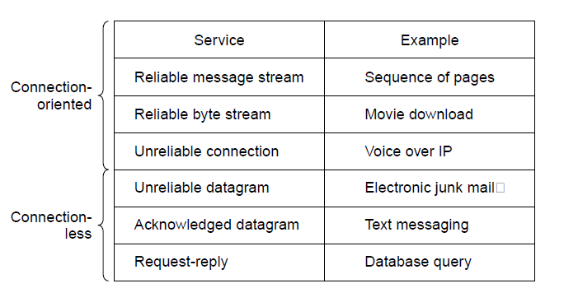
Connection-Oriented and Connectionless Services
Six different types of service.
Notes:
The concept of using unreliable communication may be confusing at first.
After all, why would anyone actually prefer unreliable communication to reliable communication?
first of all, reliable communication (in our sense, that is acknowledged.) may not be available in a given layer. For example, Ethernet does not provide reliable communication. Packets can occasionally be damaged in transit. It is up to higher protocol levels to recover from this problem. In particular, many reliable serves are built on top of an unreliable datagram service.
Second, the delays inherent in providing a reliable service may be unacceptable, especially in real-time applications such as multimedia.
For those reasons, both reliable and unreliable communication coexist.

Slide 78
Service Primitives
A service is formally specified by a set of primitives (operations) available to a user process to access the service.
These primitives tell the service to perform some action or report on an action taken by a peer entity.
If the protocol stack is located in the operating system, as it often is, the primitives are normally system calls

Slide 79
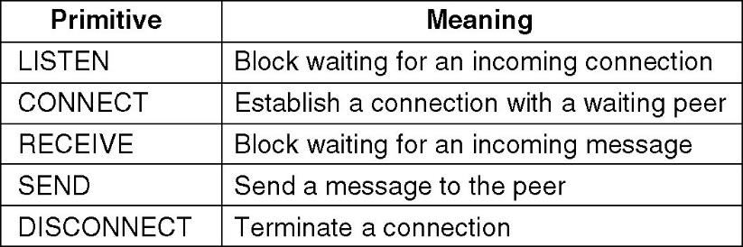
Service Primitives
Five service primitives for implementing a simple connection-oriented service.
Notes:
The set of primitives available depends on the nature of the service being provided.

Slide 80
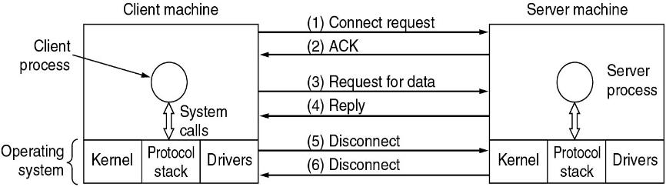
Service Primitives
Packets sent in a simple client-server interaction on a connection-oriented network.( but life is not so simple)
Notes:
These primitives might be used for a request-reply interaction in a client-server environment.

Slide 81
Services to Protocols Relationship
A service is a set of primitives (operations) that a layer provides to the layer above it. The service defines what operations the layer is prepared to perform on behalf of its users, but it says nothing at all about how these operations are implemented.
A protocol, in contrast, is a set of rules governing the format and meaning of the packets, or messages that are exchanged by the peer entities within a layer. Entities use protocols to implement their service definitions.

Slide 82
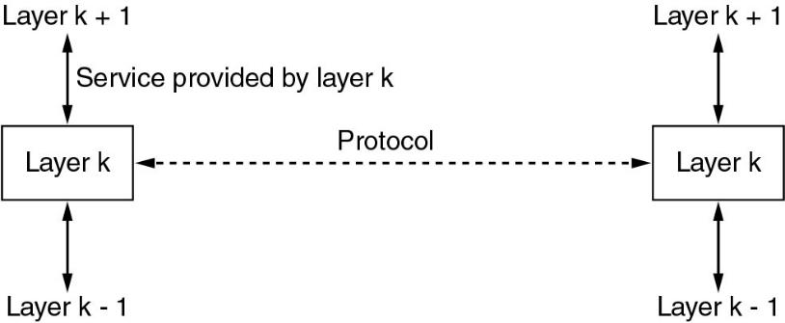
Layer K: a service and a protocol.
In other words, services relate to the interfaces between layers. In contrast, protocols relate to the packets sent between peer entities on different machines.
Notes:
An analogy with programming languages is worth making. A service is like an abstract data type or an object in an object-Oriented language. It defines operations that can be performed on an object but does not specify how these operations are implemented. In contrast, a protocol relates to the implementation of the service and as such is not visible to the user of the service.

Slide 83
1.4 Reference Models
The OSI Reference Model
The TCP/IP Reference Model
The Model used in this course
A Comparison of the OSI and TCP/IP
A Critique of the OSI Model and Protocols
A Critique of the TCP/IP Reference Model

Slide 84
OSI vs. TCP/IP reference model
The protocols associated with the OSI(Open System Interconnect) model are rarely used any more, the model itself is actually quite general and still valid, and the features discussed at each layer are still very important.
The TCP/IP model has the opposite properties: the model itself is not of much use but the protocols are widely used.
Notes:
Now that we have discussed layered networks in the abstract, it is time to look at some examples.
We will discuss two important network architectures: the OSI reference model and the TCPIP reference model.

Slide 85
The OSI Reference Model
Developed by ISO: International Standards Organization
(1983,revised in 1995)
Principles used to develop OSI Layering:
1. Need a layer for each different level of abstraction.
2. Each layer performs a well defined function.
3. Each layer should be standardizable.
4. Layer boundaries should minimize data flow across those boundaries.
5. The right number of layers - don't put too many functions together, but not too many layers either.

Slide 86
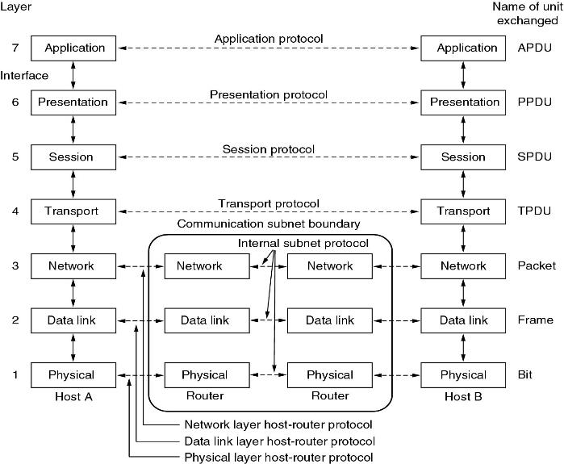
The OSI Reference Model
The OSI reference model.
1983,1995

Slide 87
Physical Layer
Purpose
Transmits raw bits across a medium.
Concerns are
Voltage: how many volts for 1 / 0
Timing: how many ns a bit lasts
Duplexing: transmission in both directions?
Connectors: how many pins? What is each pin?
etc.
Notes:
These design issues largely deal with mechanical, electrical and timing interfaces, as well as the phy trans medium, which lies below the phy layer.

Slide 88
Data Link Layer
Purpose:
Transform a raw transmission line into a line that appears free of undetected transmission errors to the networks layer
Concerns:
Framing - Breaks apart input data into frames and transmit the frames sequentially.
Error handling – if the service is reliable, the receiver confirms correct receipt of each frame by sending back an acknowledgement frame.
Flow control - keeps a fast transmitter from drowning a slow receiver in data.
Medium Access Control – how to control access to the shared channel for broadcast networks.
Notes:
Accomplish the task by

Slide 89
Network Layer
Purpose
Route packets from source to destination
Concerns
Routing - What path is followed by packets from source to destination. Can be based on a static table, can be determined when the connection is created, or can be highly dynamic, being determined anew for each packet, to reflect the current network load.
Congestion - Controls the number packets in the subnet.
Qos – Quality of service provided(delay, transit time, jitter…)
Heterogeneity - Interfacing so one type of network can talk to another. Addressing, packet size, protocols…
Notes:
The network layer controls the operation of the subnet. A key design issue is determining how packets are routed from source to destination. Routes can be based on static tables that are ''wired into'' the network and rarely changed. They can also be determined at the start of each conversation, for example, a terminal session (e.g., a login to a remote machine). Finally, they can be highly dynamic, being determined anew for each packet, to reflect the current network load.
If too many packets are present in the subnet at the same time, they will get in one another's way, forming bottlenecks. The control of such congestion also belongs to the network layer. More generally, the quality of service provided (delay, transit time, jitter, etc.) is also a network layer issue.
When a packet has to travel from one network to another to get to its destination, many problems can arise. The addressing used by the second network may be different from the first one. The second one may not accept the packet at all because it is too large. The protocols may differ, and so on. It is up to the network layer to overcome all these problems to allow heterogeneous networks to be interconnected.
In broadcast networks, the routing problem is simple, so the network layer is often thin or even nonexistent.

Slide 90
Transport Layer
Purpose
Accept data from above it, split it up into smaller units if need be, pass them to network layer, and ensure that the pieces all arrive correctly at the other end.
Concerns
Service Decisions - What type of service to provide; error-free point to point, datagram, etc.
End-to-end: it carries data all the way from the source to the destination.
Reliability - Ensures that packets arrive at their destination. Reassembles out of order messages.
Hides network - Allows details of the network to be hidden from higher level layers.
Mapping - Determines which messages belong to which connections.
Flow control - keeps a fast transmitter from flooding a slow receiver.

Slide 91
Session Layer
Purpose
Allow users on different machines to establish sessions between them
Concerns
Dialog control - keep track of whose turn it is to transmit
Token Management – prevent two parties from attempting the same critical operation at the same time
Synchronization – checkpointing long transmissions to allow them to pick up from where they left off in the event of a crash and subsequent recovery.
Notes:
Provides services that span a particular message. For instance, a login session could be logged

Slide 92
Presentation Layer
Purpose
Make it possible for computers with different data representations to communicate
Concerns
Syntax and semantics of information transmitted.
Understands the nature of the data being transmitted. Converts ASCII/EBCDIC, big endian/little endian

Slide 93
Application Layer
contains a variety of protocols that are commonly needed by users.
HTTP
FTP
SMTP
…

Slide 94
The TCP/IP Reference Models
Link layer
Internet layer
Transport layer
Application layer

Slide 95
U.S. DoD ARPANET
Was a research network sponsored by the DoD
Network be able to survive loss of subnet hardware, with existing conversations not being broken off .
A flexible architecture was needed since applications with divergent requirements were envisioned, ranging from transferring files to real-time speech transmission

Slide 96
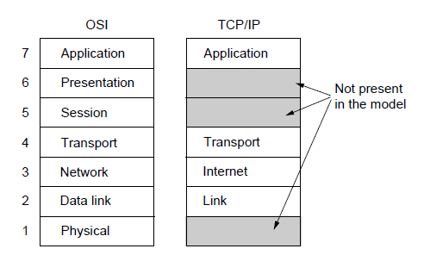
The TCP/IP Reference Models
The TCP/IP reference model
(Cerf & Kahn1974, Clark 1988)

Slide 97
The Key
a packet-switching network based on a connectionless layer that runs across different networks.

Slide 98
Link Layer
Describes what link such as serial lines and classic Ethernet must do to meet the needs of the connectionless internet layer.
It is not really a layer at all, in the normal sense of the term, but rather an interface between hosts and transmission links.

Slide 99
The Internet Layer
Permit hosts to inject packets into any network and have them travel independently to the destination ( potentially on a different network, like international mail)
Routing and Congestion control
IP (Internet Protocol)
ICMP(Internet Control Message Protocol)
Notes:
The internet layer defines an official packet format and protocol called IP (Internet Protocol). The job of the internet layer is to deliver IP packets where they are supposed to go. Packet routing is clearly the major issue here, as is avoiding congestion.
The analogy here is with the (snail) mail system. A person can drop a sequence of international letters into a mail box in one country, and with a little luck, most of them will be delivered to the correct address in the destination country. Probably the letters will travel through one or more international mail gateways along the way, but this is transparent to the users. Furthermore, that each country (i.e., each network) has its own stamps, preferred envelope sizes, and delivery rules is hidden from the users.

Slide 100
Transport Layer
End2End: Allows peer entities to communicate.
TCP - Transmission Control Protocol provides a reliable connection oriented protocol that delivers a byte stream from one node to another. Guarantees delivery and provides flow control.
UDP - User Datagram Protocol provides an unreliable connection-less protocol for applications that provide their own.
Notes:
The layer above the internet layer in the TCP/IP model is now usually called the transport layer. It is designed to allow peer entities on the source and destination hosts to carry on a conversation, just as in the OSI transport layer. Two end-to-end transport protocols have been defined here.

Slide 101
Application Layer
Terminal - Telnet
File transfer – FTP
The Web - HTTP
…
Notes:
The TCP/IP model does not have session or presentation layers. No need for them was perceived, so they were not included. Experience with the OSI model has proven this view correct: they are of little use to most applications.

Slide 102
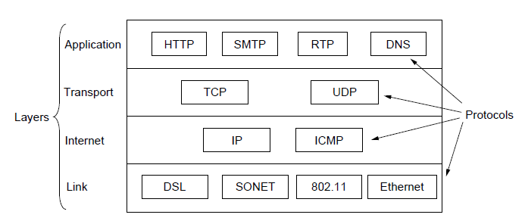
The TCP/IP Reference Models
The TCP/IP reference model with some protocols we will study

Slide 103
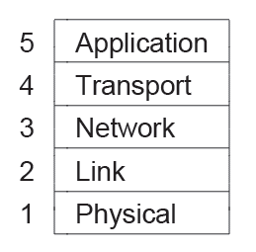
The model used in this course
The reference model used in this course.
Notes:
Our chapter sequence is based on this model. In this way, we retain the value of the OSI model for understanding network architectures, but concentrate primarily on protocols that are important in practice, from TCP/IP and related protocols to newer ones such as 802.11, SONET, and Bluetooth.

Slide 104
Comparing OSI and TCP/IP Models
Concepts central to the OSI model
Services
Interfaces
Protocols
OSI has good definition of service, interface, and protocol as discussed before. Fits well with object oriented programming concepts. Protocols are better hidden.

Slide 105
Comparing OSI and TCP/IP Models
The TCP/IP model did not originally distinguish between service, interface, and protocol.
With TCP/IP, the protocols came first; model was just a description of the protocols. But then the model isn't good for any other protocols.

Slide 106
Different philosophy
Which is first?
Reference Model
vs
Corresponding protocols

Slide 107
Specific differences
Number of layers: 7 vs. 4
Connectionless vs. connection-oriented
OSI supports both in the network layer, but only Connection-oriented communication in the transport layer
TCP/IP supports only connectionless mode in the network layer but supports both in the transport layer, giving the users a choice.

Slide 108
A Critique of the OSI Model and Protocols
Why OSI did not take over the world
Bad timing
Bad technology
Flawed, too complex
More political than technical of 7 layers decision
Bad implementations
Huge, unwieldy, Poor quality
Bad politics
Academia vs Bureaucrats
Notes:
['bjuərəukræt]
The second reason that osi never caught on is that both the model and protocols are flawed. The choice of 7 layers was more political than technical, and 2 of the layers are nearly empty, whereas 2 other ones are overfull.
unwieldy [,ʌn'wi:ldi]
adj. 笨拙的；笨重的；不灵便的；难处理的

Slide 109
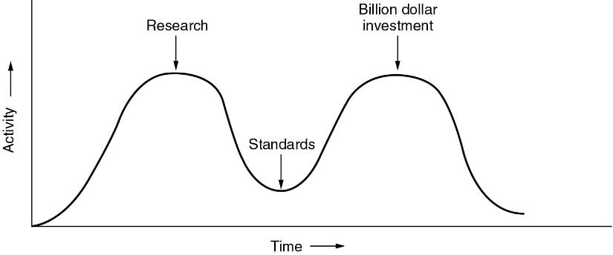
Bad Timing
The apocalypse of the two elephants.
Notes:
apocalypse 【音标】：[ə'pɔkəlips] 【词典解释】：名词 n. 1. 【宗】启示;天启 2. (the A-)《启示录》;
This figure shows the amount of activity surrounding a new subject. When the subject is first discovered, there is a burst of research activity in the form of discussions, papers, and meetings. After a while this activity subsides, corporations discover the subject, and the billion-dollar wave of investment hits.
It is essential that the standards be written in the trough in between the two ''elephants.'' If the standards are written too early, before the research is finished, the subject may still be poorly understood; the result is bad standards. If they are written too late, so many companies may have already made major investments in different ways of doing things that the standards are effectively ignored. If the interval between the two elephants is very short (because everyone is in a hurry to get started), the people developing the standards may get crushed.
It now appears that the standard OSI protocols got crushed. The competing TCP/IP protocols were already in widespread use by research universities by the time the OSI protocols appeared. While the billion-dollar wave of investment had not yet hit, the academic market was large enough that many vendors had begun cautiously offering TCP/IP products. When OSI came around, they did not want to support a second protocol stack until they were forced to, so there were no initial offerings. With every company waiting for every other company to go first, no company went first and OSI never happened.

Slide 110
A Critique of the TCP/IP Reference Model
Service, interface, and protocol not distinguished
Not a general model
Link “layer” not really a layer
No mention of physical and data link layers
Minor protocols deeply entrenched, hard to replace
Notes:
entrenched
英汉翻译
v. 确立；保证；挖掘壕沟（entrench的过去分词）
adj. 根深蒂固的；确立的，不容易改的

Slide 111
1.5 Example Networks
The Internet
3G Mobile Phone Networks
Wireless LANs: 802.11
RFID and Sensor networks

Slide 112
The history
The story begins in the late 1950s. At the height of the Cold War, the DoD wanted a command-and-control network that could survive a nuclear war.
This leads to the ARPANET:
1968 Originally intended as reliable network, with multiple routing. Used TCP/IP precursor, which got built into early UNIX.
(ARPA, the Advanced Research Projects Agency )

Slide 113
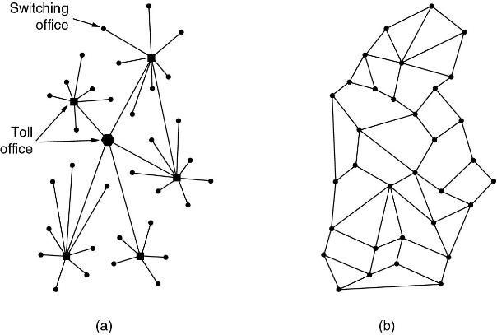
The ARPANET
(a) Structure of the telephone system.
(b) Baran’s proposed distributed switching system.

Slide 114
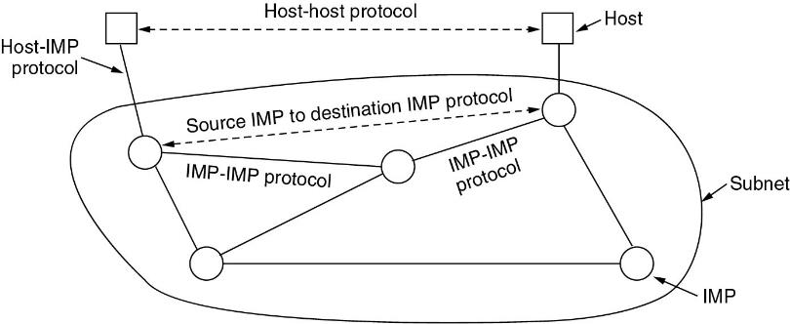
The ARPANET (2)
IMPs (Interface Message Processors)
The original ARPANET design.

Slide 115
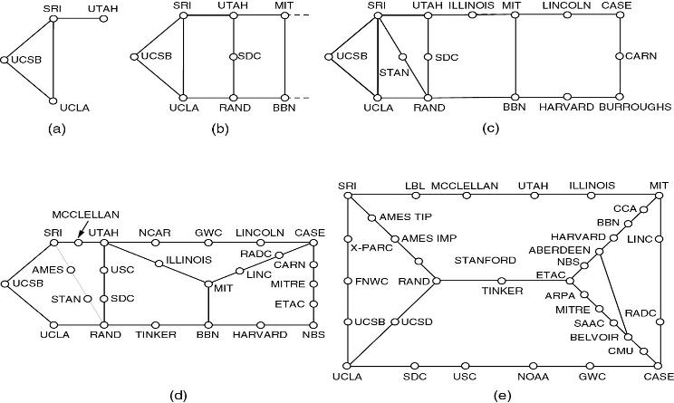
The ARPANET (3)
NAP (Network Access Point).
Growth of the ARPANET (a) December 1969. (b) July 1970.
(c) March 1971. (d) April 1972. (e) September 1972.

Slide 116
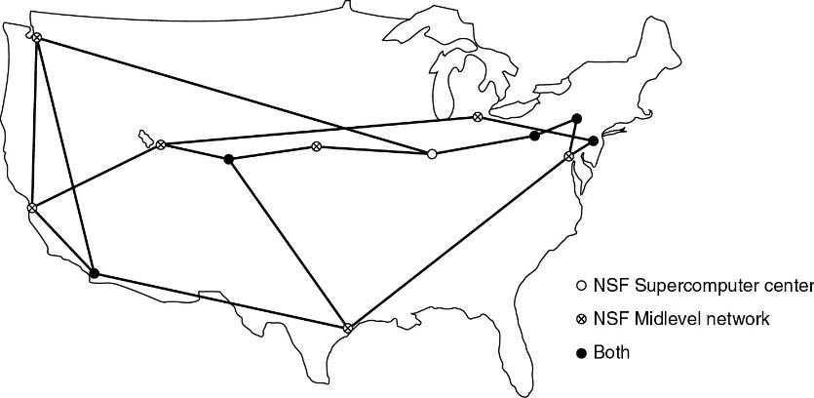
NSFNET
The NSFNET backbone in 1988.

Slide 117
NSFNET
Late 1970s - Many other folks wanted to get on the net, but Arpanet was essentially limited to military contractors. NSF set up another network to handle this need. Started at 448 Kbps and by 80's upgraded to 1.5 Mbps.
1990 Formed ANS (Advanced Networks and Services) - MERIT, MCI, IBM took over from the government running at 45 Mbps.
1995 ANSNET sold to AOL, who now runs it.

Slide 118
Internet Usage
Growing exponentially.
All nodes run TCP/IP. Means that all nodes have an IP address by which they can be contacted.
Traditional applications (1970 – 1990)
E-mail
News
Remote login
File transfer

Slide 119
Internet Usage
1990s :
the WWW (World Wide Web)
invented by CERN physicist Tim Berners-Lee
Together with the Mosaic browser
Written by Marc Andreessen at the National Center for Supercomputer Applications in Urbana, Illinois
ISPs (Internet Service Providers)
Offer individual users at home the ability to call up one of their machines and connect to the Internet

Slide 120
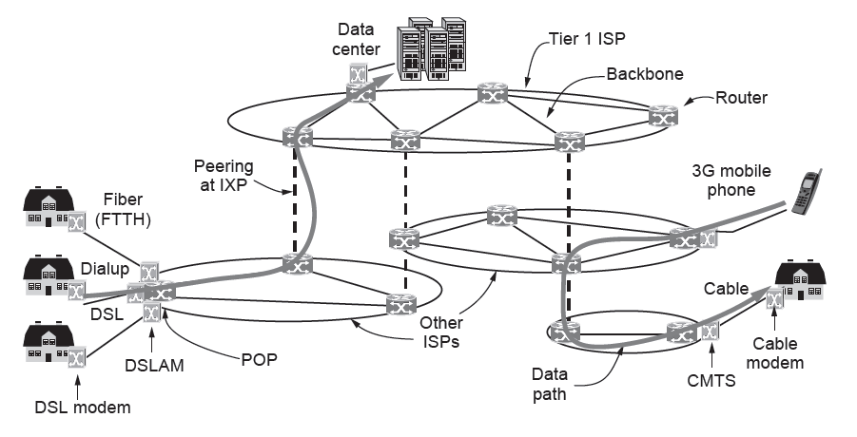
Architecture of the Internet
Overview of the Internet architecture

Slide 121
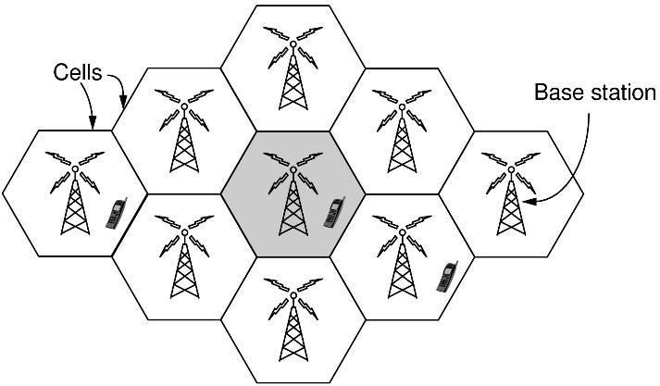
3G Mobile Phone Networks
Cellular design of mobile phone networks

Slide 122
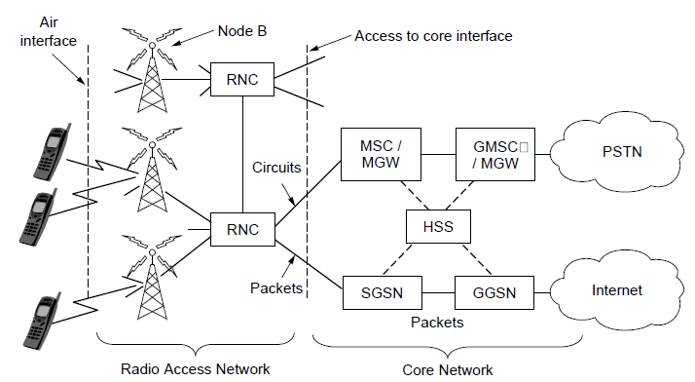
3G Mobile Phone Networks
Architecture of the UMTS 3G mobile phone network.

Slide 123
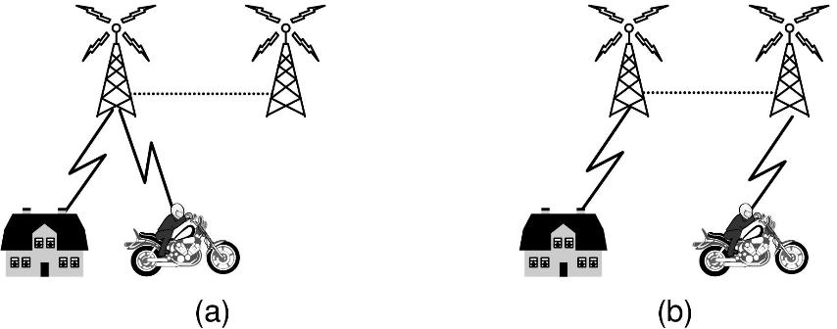
3G Mobile Phone Networks
Mobile phone handover (a) before, (b) after.

Slide 124
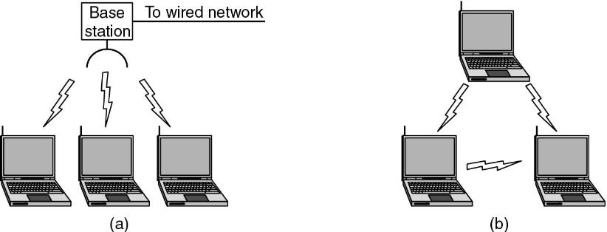
Wireless LANs - WiFi (802.11)
(a) Wireless networking with a base station.
(b) Ad hoc networking.

Slide 125
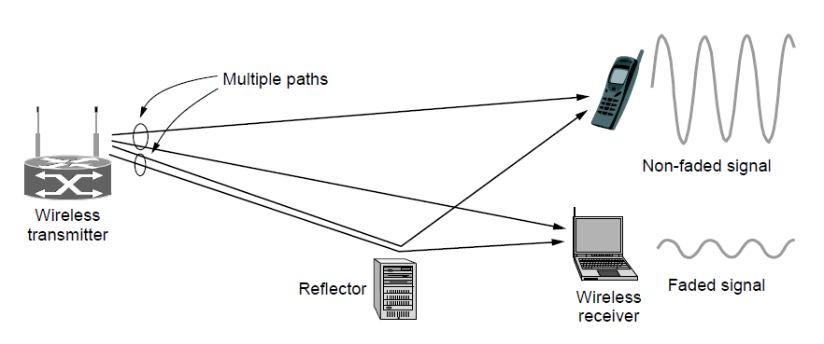
Wireless LANs: 802.11
Multipath fading

Slide 126
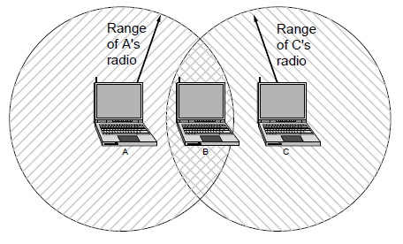
Wireless LANs: 802.11
The range of a single radio may not cover the entire system.

Slide 127
Wireless LANs standards
The development of the standard
802.11-1997: 1Mbps, 2Mbps (2.4 GHz)
802.11a-1999: 54Mbps (5 GHz band)
802.11b-1999:11Mbps(2.4 GHz)
802.11g-2003: 54Mbps (2.4 GHz)
802.11n-2009:upto 600Mbps (operates on both the 2.4 GHz and the lesser used 5 GHz bands)
802.11ac-2012:upto 1Gbps(5GHz)
Notes:
Devices operating in the 2.4 GHz range include: microwave ovens, Bluetooth devices, baby monitors, and cordless telephones.

Slide 128

RFID and Sensor Networks
RFID used to network everyday objects.

Slide 129

RFID and Sensor Networks
Multihop topology of a sensor network

Slide 130
1.6 Network Standardization
Who’s Who in the Telecommunications World
Who’s Who in the International Standards World
Who’s Who in the Internet Standards World
De facto and De jure
Notes:
Latin for from the fact and by law

Slide 131
ITU (International Telecommunication Union)
Main sectors
ITU-R: Radio communications
ITU-T: Telecommunications Standardization
ITU-D: Development
Classes of Members
National governments
Sector members
Associate members
Regulatory agencies

Slide 132
Network Standardization
ISO (International Standards Organization)
ANSI (American National Standards Institute)
NIST (National Institute of Standards and Technology)
IEEE (Institute of Electrical and Electronics Engineering)

Slide 133

IEEE 802 Standards
The 802 working groups. The important ones are marked with *.
The ones marked with ↓ are hibernating. The one marked with † gave up and disbanded itself.

Slide 134

IEEE 802 Standards
http://standards.ieee.org/about/get/802/802.html

Slide 135
Internet standards
Internet Architecture Board.
IETF: Internet Engineering Task Force
RFC: Request for comments
http://www.ietf.org/rfc
IRTF (Internet Research Task Force)
Internet Society
http://www.isoc.org

Slide 136
END OF CH-1
Notes:
Sample Lab Report
1: Introduction
topic description
Method to solve the topic
2:Main Topic
Overview
Details of the main topic
Test or operate method
3:Summary
Results and analysis
Appendix:
Duty assignments

